Slide 1
Fundamentals of Mechanical Design
Chapter 3
Cam Mechanisms
Harbin Institute of Technology (Shenzhen)

Slide 2

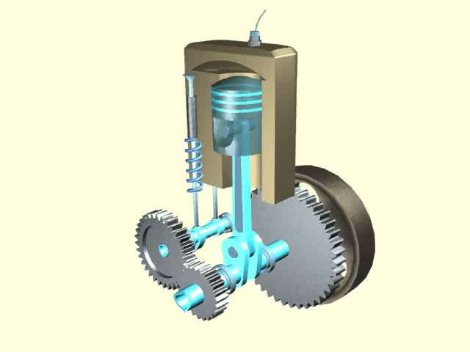
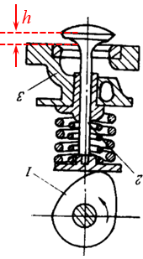
3-1 Characteristics and Applications of Cam Mechanisms
Intake Valve
Piston
Exhaust Valve
Camshaft
Automobile Engine
Intake Valve Cam
Exhaust Valve Cam
Main Shaft
How to achieve precise intake/exhaust valve control under highly dynamic, uncertain combustion conditions?
Objective: Characteristics & Applications of Cam Mechanisms
1. Understand working principle and characteristics
2. Master cam mechanism design procedure
Notes:
我们知道发动机的工作原理是通过燃烧，带动活塞做上下运动，然后通过连杆，变换成主轴的转动，主轴的转动再通过一系类机械传动，带动车轮转动。那我们来看内燃机燃烧有什么特点，是不是反应速度很快，而且是不是充满各种不确定性，那么在这种情况下它是如何做到进气门启闭的精准控制的呢。 这就和我们这节课所学的凸轮机构有关了，书上这个地方没有细讲，只是说可以用在这里，让人感觉只是有个凸起来的形状把进气门顶起来这么简单，其实真正的精髓在这。 两个基本教学目标，

Slide 3

3-1 Characteristics and Applications of Cam Mechanisms

Slide 4
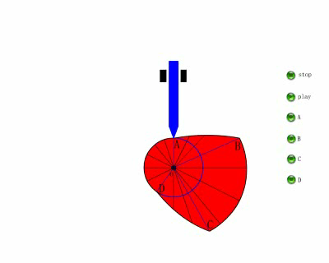

3-1 Characteristics and Applications of Cam Mechanisms
Working Principle & Characteristics
frame
push rod（follower）
Cam
（driving part）
Cam Mechanism
The cam rotates uniformly — how does it control the follower's dwell at lowest/highest points and the motion between them?
Through cam profile design, any desired motion law can be achieved — the most commonly used control mechanism in machinery.
Can a servo motor achieve any desired motion? What controls its motion?
What are the advantages?
Compared to servo motors, what are the disadvantages of cam mechanisms?

Slide 5
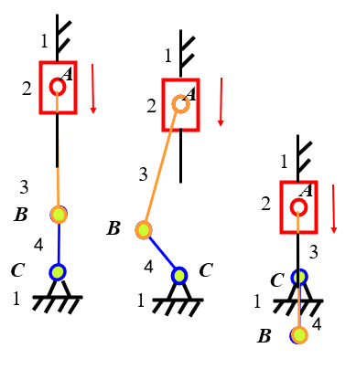
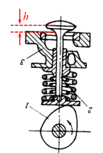










3-1 Characteristics and Applications of Cam Mechanisms
How to achieve precise intake valve control under dynamic, uncertain combustion?
Step 1: Determine requirements (when should intake valve open/close?)
How does the engine combust to drive the piston?
Intake Valve
4 Strokes: Intake, Compression, Power, Exhaust
Piston
Intake Valve State:
Open
Closed
Closed
Closed
Exhaust Valve
Camshaft
Intake Valve Cam
How many degrees does the main shaft rotate per stroke?
180°
How many degrees per complete cycle?
Exhaust Valve Cam
2
7$20°$
1
What is the function of gear transmission?
Main Shaft
Intake
Intake
进气
进气
进气门打开
gear drive
（ratio 1:2）
Intake Valve Opens
Power
Camshaft
Angular
Position
压缩
做功
排气
Compression
Exhaust
进气门关闭
Intake Valve Closes
$$0°$$
$$180°$$
$$360°$$
$$540°$$
$$720°$$
$$900°$$
主轴角度位置
$$0°$$
$$90°$$
$$180°$$
$$270°$$
$$360°$$
$$450°$$
Notes:
下面我们就用这个案例大家领略一下凸轮机构实现控制的奥妙之处，以及从应用端出发，设计凸轮的一般步骤。

Slide 6
3-1 Characteristics and Applications of Cam Mechanisms
How to achieve precise intake valve control under dynamic, uncertain combustion?
Step 3: design the cam profile according to the follower's motion law
Intake
Intake
Intake Valve
Intake Valve Opens
Power
Camshaft
Angular
Position
Compression
Exhaust
Intake Valve Closes
Piston
$$0°$$
$$90°$$
$$180°$$
$$270°$$
$$360°$$
$$450°$$
Exhaust Valve
Camshaft
How does the intake valve open?
What motion law must be satisfied?
Intake Valve Cam
Exhaust Valve Cam
push rod position
Main Shaft
h
Camshaft
Angular
Position
$$0°$$
$$90°$$
$$180°$$
$$270°$$
$$360°$$
Follower Desired Motion Law

Slide 7
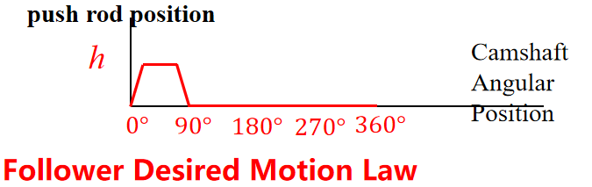
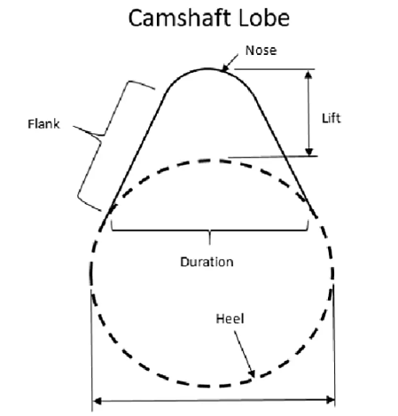
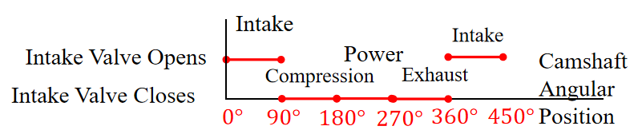

3-1 Characteristics and Applications of Cam Mechanisms
How to achieve precise intake valve control under dynamic, uncertain combustion?
Step 2: Design the desired follower motion law
Intake Valve
Piston
Exhaust Valve
Camshaft
Intake Valve Cam
Cam Profile
Exhaust Valve Cam
$$φ$$
Main Shaft
What is φ? Analyze from working principle — why?
90°

Slide 8
Discussion
How to achieve precise intake valve control under dynamic, uncertain combustion?
Can electronic control be used instead?
Intake Valve
Add an electric motor?
Piston
When to send drive signals?
Exhaust Valve
Camshaft
Add sensors and controller for closed-loop system
Automatically send drive signals?
Intake Valve Cam
What to measure? Where to place sensors?
Exhaust Valve Cam
Measure main shaft angular position?
Main Shaft
What characterizes the kinetic energy from engine combustion?
Response speed? Reliability?

Slide 9
Discussion
How to achieve precise intake valve control under dynamic, uncertain combustion?
Advantages of purely mechanical automation vs. electronic control:
1. Can share a single power source
（No additional drive, sensor, or controller required.）
Intake Valve
2. Perfect synchronization — no response lag
(Overwhelming advantage)
Piston
Exhaust Valve
Camshaft
3. High reliability and durability
Electronic components are sensitive to environment (temperature, humidity, EMI...)
Intake Valve Cam
Disadvantages of purely mechanical automation vs. electronic control:
1. Less flexible for function changes
Exhaust Valve Cam
2. Transmission errors, difficult to compensate in real-time
Main Shaft
3. Weaker sensing and intelligence capabilities
Choose the one dialectically based on characteristics!

Slide 10

Summary
1. How does a cam mechanism control motion?
Step 1: Determine requirements
2. What are the steps of cam mechanism design?
Intake Valve
Piston
Exhaust Valve
Step 2: Design desired follower motion law
Camshaft
Intake Valve Cam
Exhaust Valve Cam
Step 3: Design cam profile based on motion law
Main Shaft
3. Pros and cons of mechanical vs. electronic automation?
(Supplementary)
$$φ$$

Slide 11
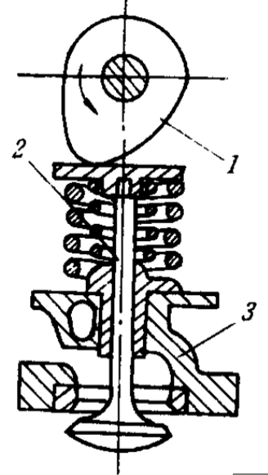
3-2 Classification of Cam Mechanisms
Why use a flat face?
3-1 Characteristics & Applications
3-2 Classification of Cam Mechanisms
3-3 Follower Motion Laws & Selection
3-4 Graphical Design of Cam Profiles

Slide 12
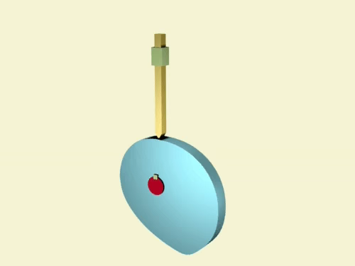
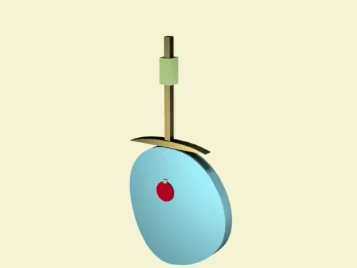
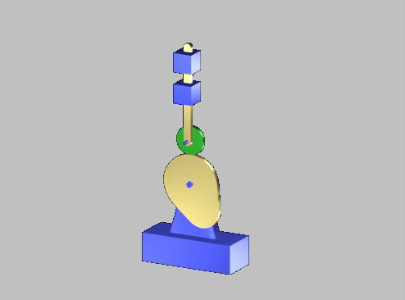
3-2 Classification of Cam Mechanisms
Classified by Contact Surface Shape
(How to select/design follower contact shape?)
1. Knife-edge Follower
2. Roller Follower
3. Flat-faced Follower
Advantages of knife-edge?
Advantages of roller?
Advantages of flat face?
Simple structure
Rolling friction — reduced wear
Higher load capacity
Easy oil film formation, good lubrication
Can maintain contact with complex profiles, achieve any motion law
Profile contact issue — what about concave cam profiles?
Pressure angle always = 0°, excellent force transmission
Disadvantages of knife-edge?
Small contact area
Sliding friction, wear easily
Flat face cannot maintain full contact with concave profile sections,
limiting accurate motion law realization

Slide 13
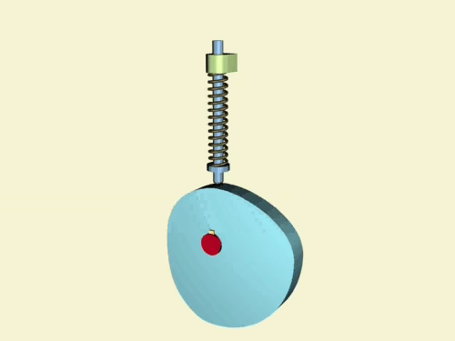
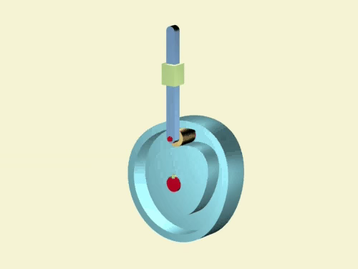
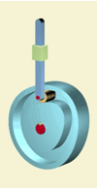
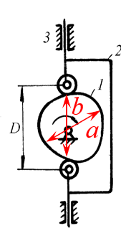
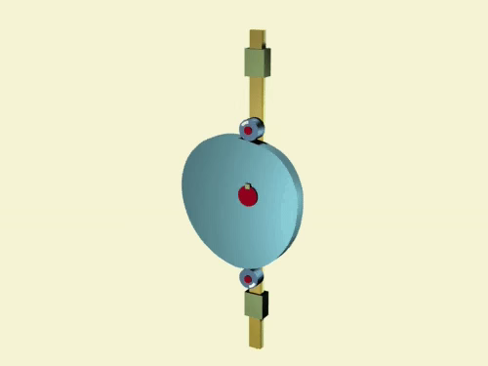
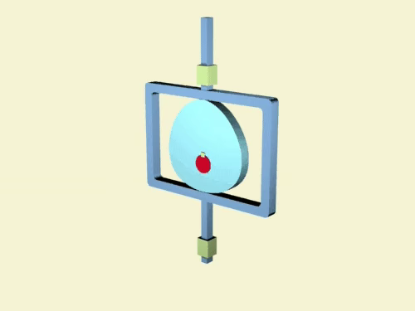
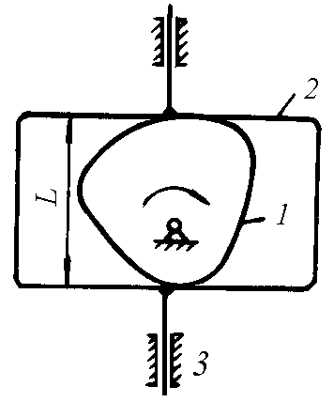
3-2 Classification of Cam Mechanisms
Classified by Higher-Pair closure Method
(How to select/design closure method?)
1. Force closure (spring force, gravity, magnetic force, etc.)
What is the function of the spring?
How is higher-pair closure achieved?
Uses spring force to maintain contact (higher-pair closure)
Gravity
2. Form closure (geometry-based closure)
Constant-width Cam
Grooved Cam
Yoke Follower
(Roller)
Constant-diameter Cam
Yoke Follower
(Flat-faced)
m
e₁
e₂
The cam must meet the specified requirements.e₁ =e₂ =Roller diameter
Cam diameters must be equal
(e.g., a = b = D - roller diameter)
Cam width must be constant (e.g., m = L)

Slide 14
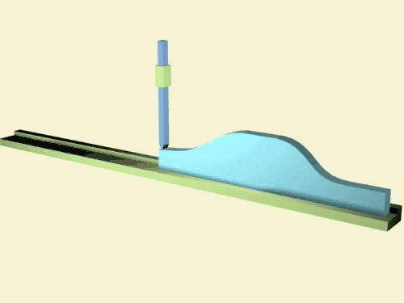
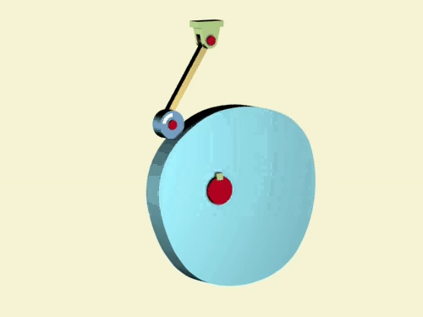
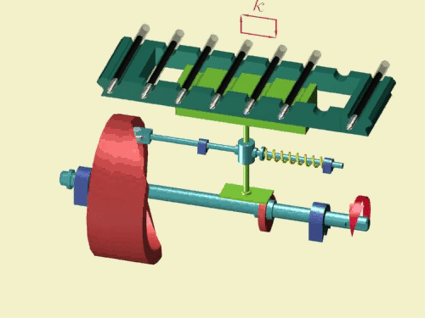
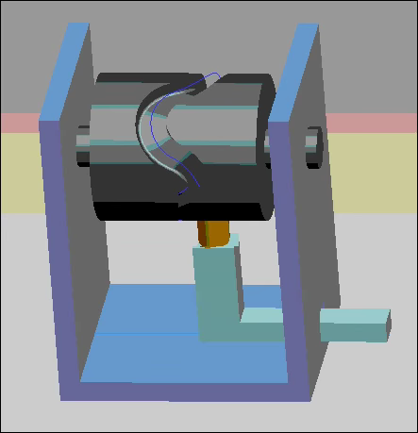
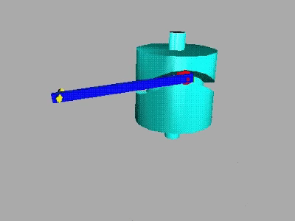
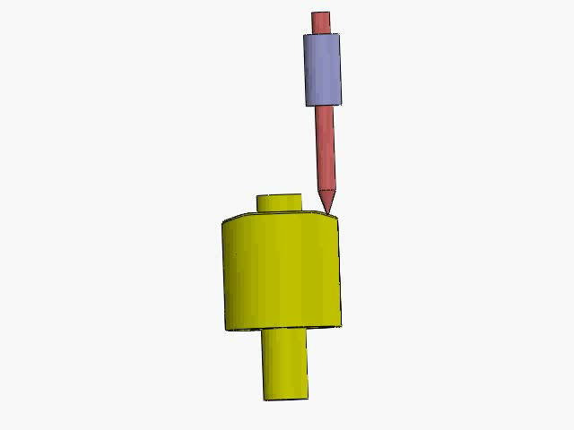
3-2 Classification of Cam Mechanisms
Rotary
Planar
Spatial
Cam：
Follower：
or Translational...
Classified by Motion Form
Classified by Cam Profile
(Planar or Spatial?)
Translational
or Rotary (Oscillating)...
Follower becomes oscillating
What are the characteristics of spatial cam mechanisms?
1. Compact structure
Driving part becomes translational
2. Motion direction parallel to rotation axis
Driving part: Rotary
Rectangular workpiece trajectory
follwer: Translational
Wrap planar cam into a cylindrical tube
Planar Cam Mechanism
Follower becomes oscillating
Enclose the cam
Higher-pair form closure
Vertical displacement
Gentle pick-and-place
Spatial Cam Mechanism

Slide 15
Content Review
frame
1
What are the advantages of automation based on mechanical transmission?
push rod（follower）
A
Shared power source
No separate drive–transmission–control chain is required.
B
True synchronization
Cam
（driving part）
Motion is fully synchronized, with no response delay.
C
Practical performance
Cam Mechanism
Durable, reliable, and low-cost.
2
What is the most commonly used control mechanism?
CAM MECHANISM
CAM
FOLLOWER
FRAME
Kinematic pair
Higher pair
Motion control
Cam profile
Notes:
Let's do a quick review quiz on what we've covered:
**Q1: Advantages of mechanical automation?** [P]
(a) Shared power source — no separate drive/transmission/control hardware; (b) perfect synchronization — no response time; (c) durability, reliability, low cost.
**Q2: The most common control mechanism in mechanical automation? Its composition? Higher or lower pair? What controls motion?** [P]
The cam mechanism. Composed of cam, follower, and frame. It is a higher-pair mechanism. The cam profile controls the motion.
A lower pair is formed by surface contact, while a higher pair is formed by point or line contact between two rigid members. Typical higher pairs include cam-follower pairs and gear meshing pairs.

Slide 16
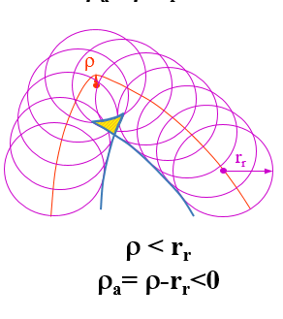
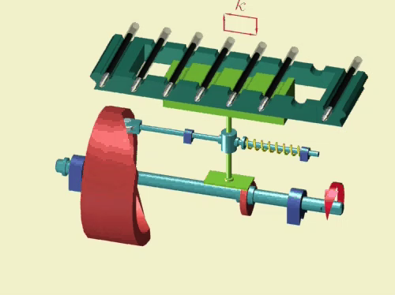
Content Review
3
Follower types classified by the shape of the contact element
Knife-edge
Roller
Flat-faced
Advantages
Advantages
Advantages
Simple structure
Any prescribed motion law
Rolling friction
Lower contact wear
Pressure angle α = 0
Compact contact
Limitation / condition
Limitation / condition
Limitation / condition
Limitation / condition
Limitation / condition
High wear
Convex profile: ρ_{min} > r_{r}
Concave profiles may distort motion
4
What is closure of a kinematic pair?
5
Driving and driven members
The two members remain in continuous contact throughout the motion.
Either member may rotate or translate.
Spatial cam advantages
FORCE CLOSURE
Gravity · spring · magnetic force
FORM CLOSURE
Geometric constraint maintains contact
Compact structure; can be combined with planar cams to generate two-dimensional motion along arbitrary trajectories.
Notes:
**Q3: Classification by follower contact shape, and pros/cons?** [P]
- Knife-edge: simple, any trajectory,容易 wear.
- Flat-faced: pressure angle = 0, but concave profile → motion distortion.
- Roller: rolling friction, but for convex profiles require ρmin > rr.
**Q4: What is kinematic pair locking? Classification?** [P]
Keeping the two paired components in constant contact during motion. Force locking (gravity, spring, magnetic) and form locking (geometry of driving/driven members).
**Q5: Motion types of driving/driven links? Advantages of spatial cams?** [P]
Rotary or translational. Spatial cams are compact and can combine with planar cams to produce arbitrary 2D trajectories.

Slide 17
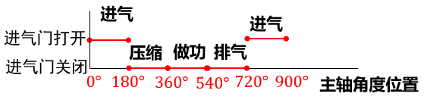
3-3 Follower Motion Laws & Selection
Flat-faced Follower
3-1 Characteristics & Applications
3-2 Classification of Cam Mechanisms
3-3 Follower Motion Laws & Selection
3-4 Graphical Design of Cam Profiles

Slide 18






3-3 Follower Motion Laws & Selection
I. Motion Cycle of Cam Mechanisms
What is the base circle?
The cam rotates uniformly about point O with angular velocity ω
Base Circle: The circle formed by the minimum radius of the cam profile
$\hat{AB}、\hat{BC}$ arc（Circle O）
r₀: Base Circle Radius
What are rise, dwell at max lift, return, dwell at min lift?
Push rod motion trajectory
What are rise angle, dwell angle at max, return angle, dwell angle at min?
s
A’
h
What is the lift (stroke)?
h
A
0
$$φ$$
D
r₀
推程
远休止
回程
近休止
O
rise, dwell at max lift, return, dwell at min lift
M
ω
B
Base Circle
C

Slide 19















3-3 Follower Motion Laws & Selection
In a radial roller follower disk cam, the actual cam profile is a circle centered at A.
The cam rotates uniformly counterclockwise about point O.
Roller radius
Red
(1) Pitch curve: red or blue?
(2) Base circle radius
(4) The displacement of the follower at the given position; the stroke of the driven member；
(5) Maximum pressure angle during rise
Calculate base circle radius and pressure angle using the pitch curve, NOT the actual profile.
25
(3) Lift h
50
Draw the line and measure according to the scale
30°
B
$$F$$
$$α$$
$$v↑$$
$$R+r_{r}$$
$$α$$
B
Pressure Angle: The acute angle α between the direction of the force acting on the point of force application on the follower and the absolute velocity direction of that point.
D
$$l_{OA}$$
When OA is perpendicular to OB, the pressure angle α is maximum. Why?

Slide 20
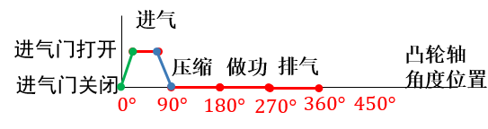
3-3 Follower Motion Laws & Selection
II. Common Follower Motion Laws
Research question: How to select/design follower motion from point A to B
(e.g., how to open and close the intake valve)
1. Constant Velocity Motion
2. Constant Acceleration/Deceleration Motion
3. Simple Harmonic Motion (Cosine)
4. Cycloidal Motion (Sine)

Slide 21
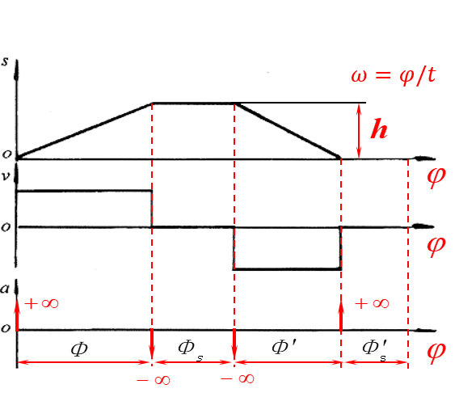

1. Constant Velocity — Linear Motion Law
3-3 Follower Motion Laws & Selection
What are the acceleration characteristics?
Impact characteristic: Acceleration → ∞ at start and end points
$$\text{t}=φ/ω$$
Impact caused by sudden acceleration change to infinity is called
Rigid impact — generates enormous inertial force, causing severe shock
13

Slide 22
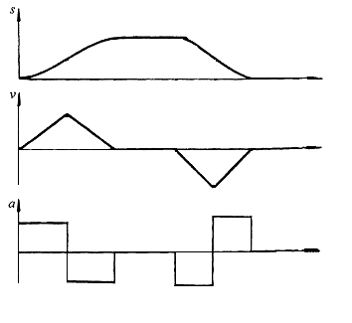







3-3 Follower Motion Laws & Selection
2. Constant Acceleration/Deceleration — Quadratic Motion Law
Impact characteristic: Finite sudden change in acceleration
$$\text{t}=φ/ω$$
Impact caused by finite acceleration change = Flexible impact
Flexible impact: suitable for low/medium speeds,
can still cause problems at high speeds

Slide 23
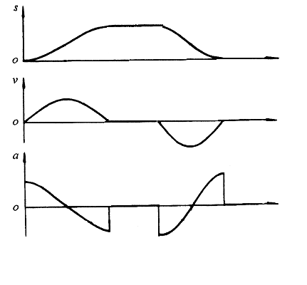







3-3 Follower Motion Laws & Selection
3. Cosine Acceleration (Simple Harmonic) Motion
Any rigid impact?
No
$$\text{t}=φ/ω$$
Any flexible impact?
Yes
Flexible impact: suitable for low/medium speeds,
can still cause problems at high speeds

Slide 24
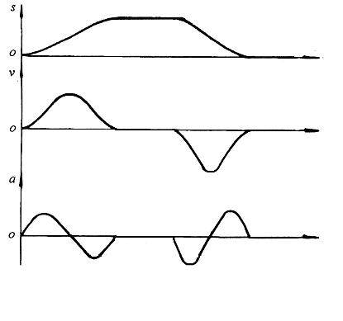

3-3 Follower Motion Laws & Selection
4. Sine Acceleration (Cycloidal) Motion
Any rigid impact?
No
$$\text{t}=φ/ω$$
Any flexible impact?
No
Smooth motion, suitable for heavy loads and high speeds
Disadvantages compared to constant velocity?
Complex trajectory → complex cam profile → higher precision requirement and cost

Slide 25
3-4 Graphical Design of Disk Cam Profiles
Spindle Position Angle
3-1 Characteristics & Applications
3-2 Classification of Cam Mechanisms
3-3 Follower Motion Laws & Selection
3-4 Graphical Design of Cam Profiles
Notes:
Now we come to **3-4: the graphical method for designing disk cam profiles**.
**Basic principle.** The cam rotates CCW at constant speed; the follower translates along its guide. The follower rises by h as the cam rotates from point B to point A.
**[Q]** How can we find point B's position when h is known? [P]
The key trick is the **inversion method (反转法)**: fix the cam, and move everything else with a reverse rotation −ω. This does not change the relative motion between the cam and the follower — it's a purely kinematic transformation. It makes drawing much easier because the cam stays still on the page.
[CLICK — inversion animation]
**[P]** Emphasize: 'Cam does not move, everything else moves' — the frame rotates backward, and the follower moves along its rotating guide with its own prescribed motion. The envelope of follower positions gives the cam profile.

Slide 26
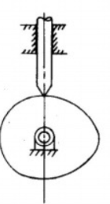




3-4 Graphical Design of Disk Cam Profiles
Basic Principle of Cam Profile Design
-120°
s
A
h
$$φ$$
O
r₀
A
0
O
B
Cam CCW rotation
r₀
h
When rotating from B to A, what is the follower rise?
A
O
h
ω
Given h, how to find point B?
B
For ease of drawing, can we fix the cam and determine point B's position?
"Inversion Method": The cam remains stationary; the other components move (without altering the relative motion pattern).
What motion should the frame perform?？
CW rotation
What motion does the pusher's guide path perform?
CW rotation
What motion does the pusher perform？
Translation along rotating guide
Notes:
**Basic principle.** The cam rotates CCW at constant speed; the follower translates along its guide. The follower rises by h as the cam rotates from point B to point A.
**[Q]** How can we find point B's position when h is known? [P]
The key trick is the **inversion method (反转法)**: fix the cam, and move everything else with a reverse rotation −ω. This does not change the relative motion between the cam and the follower — it's a purely kinematic transformation. It makes drawing much easier because the cam stays still on the page.
[CLICK — inversion animation]
**[P]** Emphasize: 'Cam does not move, everything else moves' — the frame rotates backward, and the follower moves along its rotating guide with its own prescribed motion. The envelope of follower positions gives the cam profile.

Slide 27
Radial Knife-edge Follower Disk Cam
3-4 Graphical Design of Disk Cam Profiles
s
Given: Follower motion law, cam rotates CCW
Design: Cam profile
h
$$φ$$
0
Inversion method: Fix cam, move everything else
(Relative motion unchanged)
-ω
O
1. Find the contact point when cam rotates 190°.
2. If 190° can be drawn, can any angle be drawn similarly?
ω
Sure! How about 90°?
3. After drawing 0°~360°, is the cam profile designed?
4. Advantages and disadvantages of knife-edge follower?
Simple structure, wear easily
Notes:
Example: radial knife-edge follower disk cam.
Given the follower motion law and CCW cam rotation, design the cam profile.
**1.** Find the contact point when the cam rotates 190°. [P] Use inversion: rotate the follower guide by −190°, mark the follower position from the motion law, and the contact point is where the follower tip touches the cam. (lift)
**2.** If 190° can be drawn, can any angle be drawn the same way? [P] Sure! How about 90°? [P] Demonstrate.
**3.** After drawing all angles from 0° to 360°, is the cam profile designed? [P] Yes — connecting the follower tip positions gives the profile.
**4.** Advantages and disadvantages of the knife-edge follower? [P] Simple structure, but wear easily (sliding contact, high contact stress).

Slide 28


Offset Knife-edge Follower Disk Cam
3-4 Graphical Design of Disk Cam Profiles
Inversion method: Fix cam, move everything else
(Relative motion unchanged)
Given: r₀, offset circle radius e, follower motion law, cam CCW
Design: Cam profile
s
h
$$φ$$
1. What is the relationship between guide direction and offset circle?
0
Always tangent
Offset Circle
-ω
Offset e
2. Find the actual contact point at 190° rotation.
3. If 190° can be drawn, can any angle be drawn similarly?
Sure!
ω
22
Notes:
Now the follower guide is offset from the cam center by distance e. The offset circle (偏距圆) has radius e, centered at the cam center.
**[Q]** What is the relationship between the guide direction and the offset circle? [P] **Always tangent.** During inversion, the guide always remains tangent to the offset circle.
**[P]** Construct: draw the offset circle; invert the guide step by step (−ω); lay off the follower displacement from the motion law along each tangent; the follower tip positions define the profile.
**2.** Find the actual contact point at 190° rotation. **3.** Any angle drawable? Sure!

Slide 29
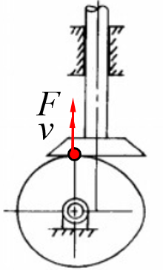
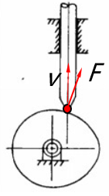

3-4 Graphical Design of Disk Cam Profiles
Radial Flat-faced Follower Disk Cam
s
h
Given: Follower motion law, cam rotates CCW
Design: Cam profile
$$φ$$
0
1. Find the contact point when cam rotates 190°.
Inversion method: Fix cam, move everything else
(Relative motion unchanged)
-ω
2. If 190° can be drawn, can any angle be drawn similarly?
Sure!
The envelope of all flat-face positions gives the desired cam profile.
actual profile
O
3. Advantages of flat face?
Disadvantages?
Profile contact issue: What about heart-shaped (concave) cam profiles?
ω
Flat face cannot fully contact concave sections, limiting accurate motion realization.
Flat face: high transmission efficiency

Slide 30
3-4 Graphical Design of Disk Cam Profiles
Extension: Oscillating Follower Disk Cam Design
φ₂
Given: Frame length, follower motion law, cam CCW
Design: Cam profile
Φ
φ₁₉₀
$$φ$$
0
Inversion method: Fix cam, move everything else
(Relative motion unchanged)
-ω
190°
O
1. Find the contact point when cam rotates 190°.
190°
2. If 190° can be drawn, can any angle be drawn similarly?
φ₁₉₀
ω
Sure!

Slide 31
Content Review
1. What are the advantages of realizing automation based on mechanical transmission?
(a) A common power source can be shared, with no separation of "drive, transmission and control".
(b) Full synchronisation can be achieved (no response time required).
2. What is the most commonly used control mechanism for automation implemented by mechanical transmission? What is it composed of? Is it a higher pair or lower pair mechanism? What controls its motion?
Cam mechanism;
Cam, follower and frame;
Higher pair mechanism;
The profile of the cam.

Slide 32
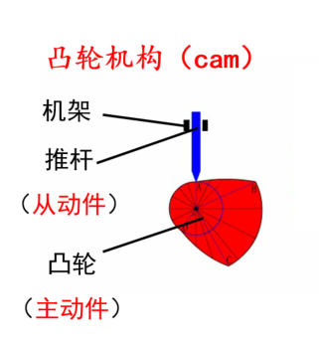
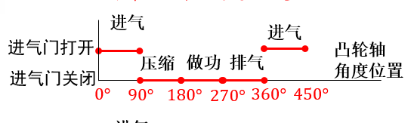
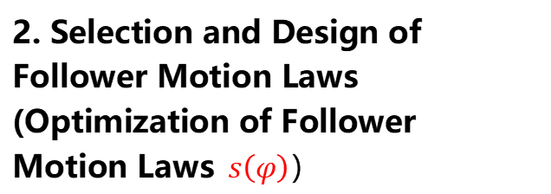
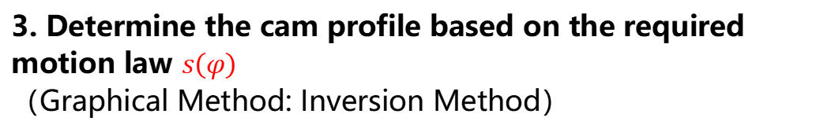
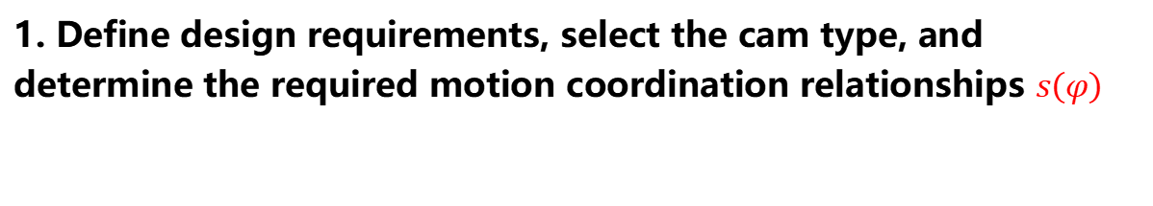
Content Review
General Cam Design Procedure
1. Define design requirements, select the cam type, and determine the required motion coordination relationships $s（φ）$
2. Selection and Design of Follower Motion Laws (Optimization of Follower Motion Laws$s（φ）$）
Constant velocity, constant accel/decel...
(Rigid/flexible impact vs. complexity)
3. Determine the cam profile based on the required motion law $s（φ）$
（Graphical Method: Inversion Method）

Slide 33
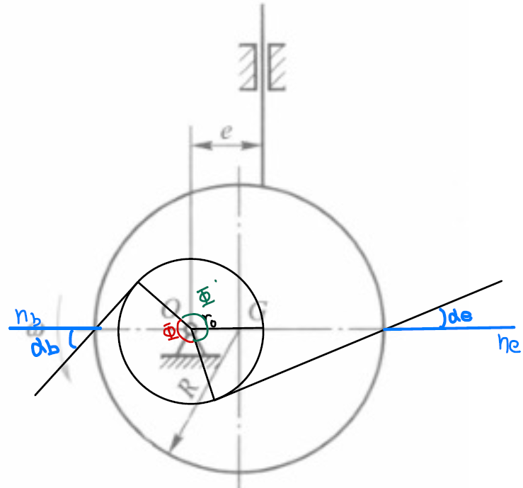
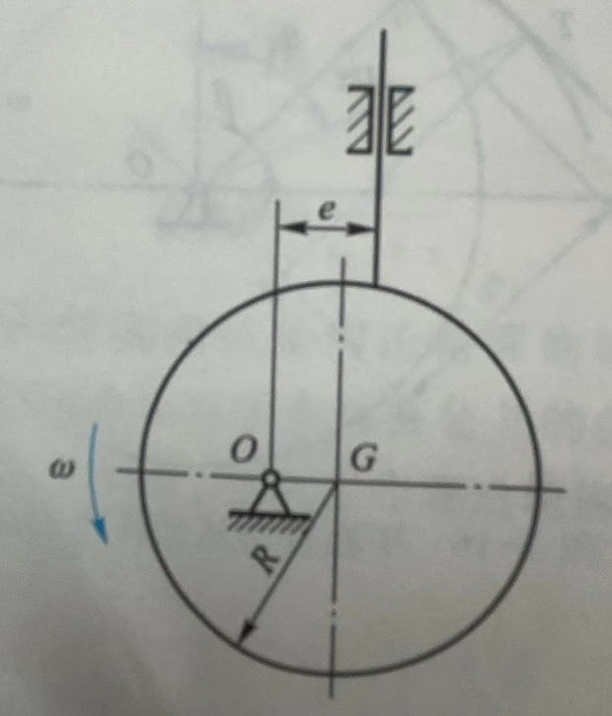
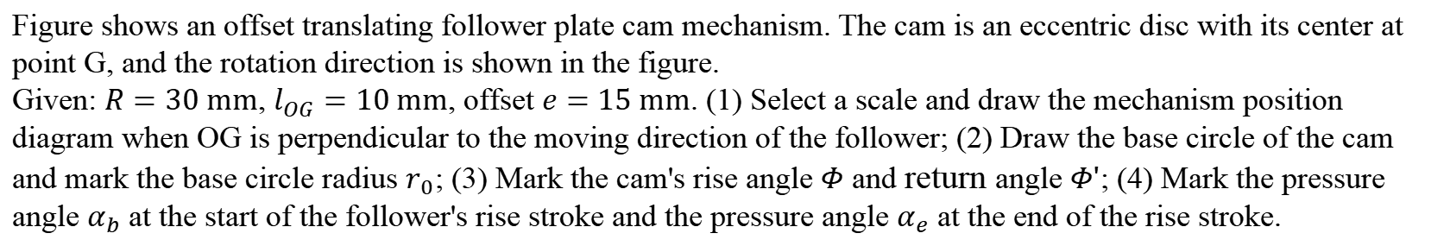
Practice Problem
Figure shows an offset translating follower plate cam mechanism. The cam is an eccentric disc with its center at point G, and the rotation direction is shown in the figure.
Given: $R=30 mm$, $l_{OG}=10 mm$, offset $e=15 mm$. (1) Select a scale and draw the mechanism position diagram when OG is perpendicular to the moving direction of the follower; (2) Draw the base circle of the cam and mark the base circle radius $r_{0}$; (3) Mark the cam's rise angle $Φ$ and return angle $Φ'$; (4) Mark the pressure angle $α_{b}$ at the start of the follower's rise stroke and the pressure angle $α_{e}$ at the end of the rise stroke.
How to find rise angle and return angle?
Guide direction is always tangent to offset circle
Where are the lowest and highest follower positions?
B

Slide 34
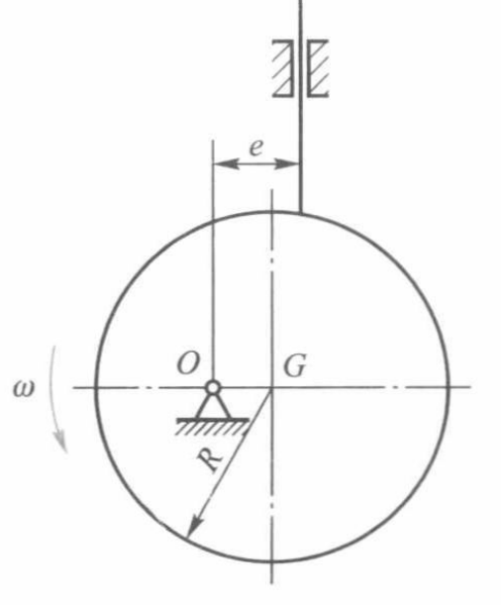
Practice Problem
Figure shows an offset translating follower plate cam mechanism.Cam 1 is an eccentric circular disk of radius R, with its geometric center at G. The rotation direction is shown.
Given
R = 30 mm OG = 10 mm e = 15 mm
Choose a suitable scale. Draw the mechanism when OG is perpendicular to the follower’s direction of translation.
1
2
Draw the cam base circle and label its radius r₀.
3
Indicate the rise angle Φ and the return angle Φ′.
4
Indicate the pressure angle αᵦ at the beginning of rise and αₑ at the end of rise.

Slide 35
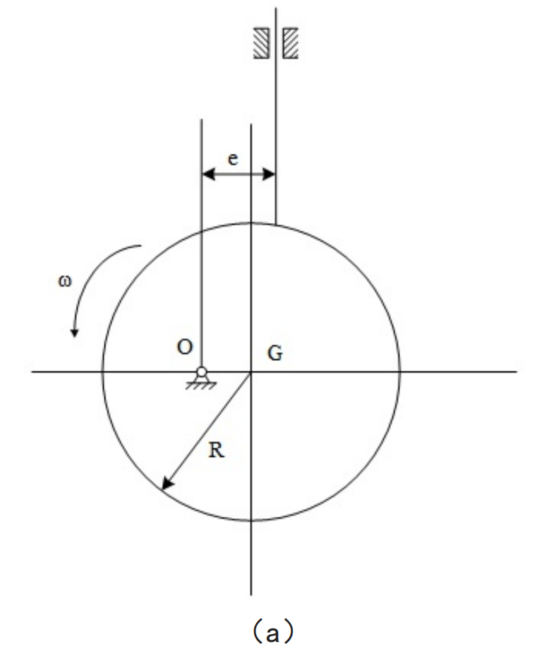
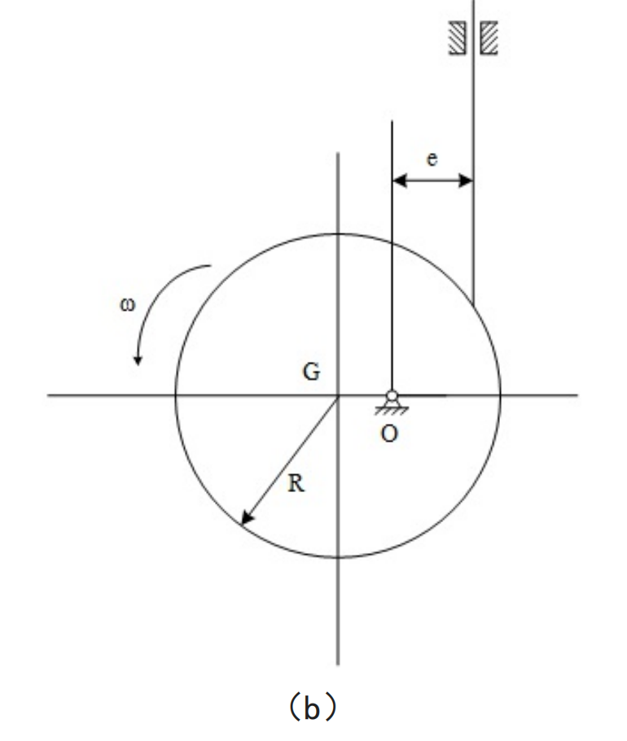
Practice Problem
Offset translating flat-faced follower cam
Cam 1 is an eccentric circular disk of radius R, with its geometric center at G. The rotation direction is shown.
Given
R = 30 mm OG = 10 mm e = 15 mm
Choose a suitable scale. Draw the mechanism when OG is perpendicular to the follower’s direction of translation.
1

Slide 36
Practice Problem
Figure shows an offset translating follower plate cam mechanism.Cam 1 is an eccentric circular disk of radius R, with its geometric center at G. The rotation direction is shown.
Given
R = 30 mm OG = 10 mm e = 15 mm
2
Draw the cam base circle and label its radius r₀.
Indicate the rise angle Φ and the return angle Φ′.
Guide direction is always tangent to offset circle
3
Indicate the pressure angle αᵦ at the beginning of rise and αₑ at the end of rise.
B
4
How to find rise angle and return angle?
Where are the lowest and highest follower positions?

Slide 37

Radial Roller Follower Disk Cam
3-4 Graphical Design of Disk Cam Profiles
Given: r₀, follower motion law, roller radius rr,
cam CCW rotation. Design: cam profile
s
h
$$φ$$
0
-ω
1. Find the pitch curve position at 190° rotation.
2. If 190° can be drawn, can any angle be drawn similarly?
ω
Sure!
pitch curve
3. How to draw the actual profile?
actual profile
Draw the envelope!

Slide 38
Roller Radius Selection
3-4 Graphical Design of Disk Cam Profiles
Actual profile curvature radius：ρ_{a}
Pitch curve curvature radius：ρ
Roller Radius: r_{r}
theoretical
r_{r}
ρ
1 inner concave cam profile
ρ_{a}= ρ+r_{r}
actual
ρ_{a}
r_{r}
ρ
ρ_{a}
Is there any restriction on roller radius r_{r} ？
ρ>r_{r}
ρ_{a}= ρ+r_{r}
No — for convex profiles, any roller radius can produce a valid actual profile.
ρ_{a}= ρ-r_{r}>0
2 outer convex cam profile ρ_{a}= ρ-r_{r}
ρ
ρ>r_{r}，ρ_{a}>0，actual profile smooth
ρ
ρ=r_{r}，ρ_{a}=0 ？
Actual profile becomes sharp →wear easily, motion distortion
r_{r}
r_{r}
ρ<r_{r}，ρ_{a}<0？
The actual contour exhibits intersection, cutting, or motion distortion.
ρ = r_{r}
ρ < r_{r}
Is there a restriction on roller radius for convex profiles?
ρ_{a}= ρ-r_{r＝}0
ρ_{a}= ρ-r_{r}<0
ρ_{min}>r_{r} ，make sure ρ_{amin} = ρ_{min} -r_{r} ≥ [ρ_{a}] =3~5 mm
Reduce roller radius or increase base circle radius and redesign.
24

Slide 39
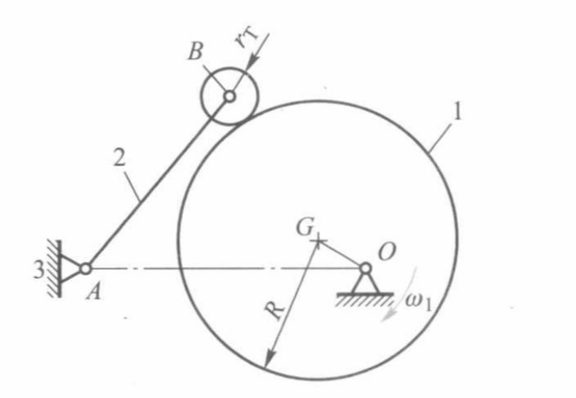
Practice Problem
The figure shows a cam mechanism with oscillating roller follower. Cam 1 is an eccentric circular disk of radius R, centered at G. Follower 2 oscillates about A and carries a roller at B.
Given
R = 25 mm OG = 10 mm OA = 50 mm
AB = 40 mm roller radius r_{T} = 5 mm
1
Choose a suitable scale. Draw the configuration when angle AOG equals 30°.
2
Draw the cam base circle and label its radius r₀.
3
Indicate the rise angle Φ and the return angle Φ′.
4
Indicate the pressure angle α of follower 2 at the position shown.

Slide 40
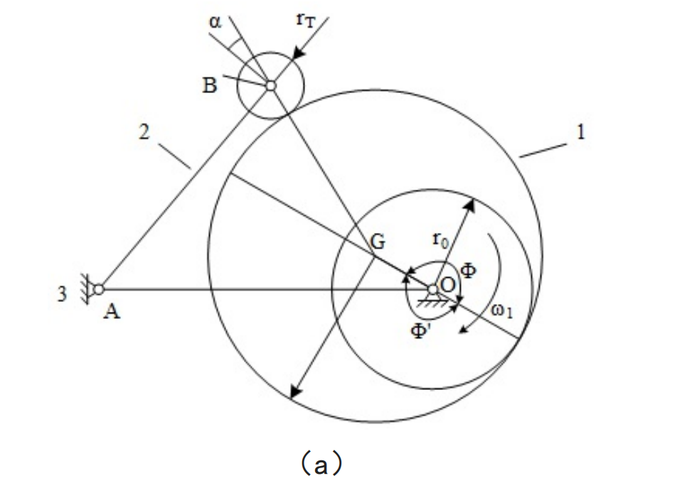
Practice Problem
The figure shows a cam mechanism with oscillating roller follower. Cam 1 is an eccentric circular disk of radius R, centered at G. Follower 2 oscillates about A and carries a roller at B.
Given
R = 25 mm OG = 10 mm OA = 50 mm
AB = 40 mm roller radius r_{T} = 5 mm
1
Choose a suitable scale. Draw the configuration when angle AOG equals 30°.
2
Draw the cam base circle and label its radius r₀.
3
Indicate the rise angle Φ and the return angle Φ′.
4
Indicate the pressure angle α of follower 2 at the position shown.

Slide 41
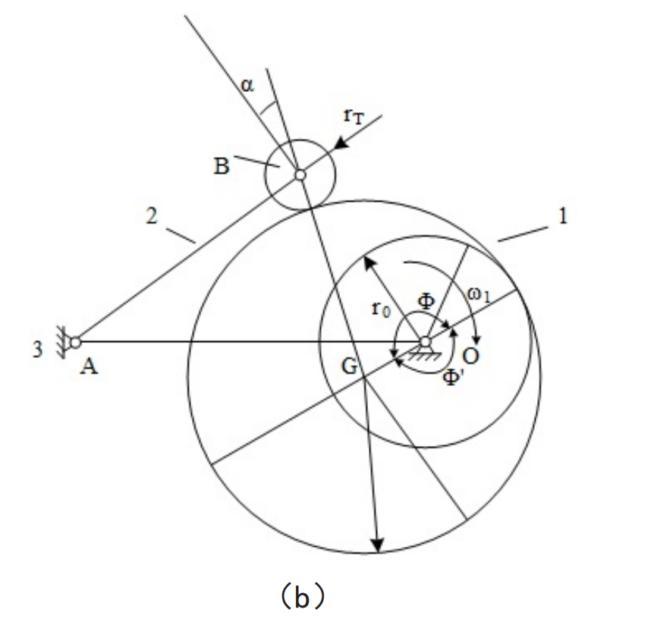
Practice Problem
The figure shows a cam mechanism with oscillating roller follower. Cam 1 is an eccentric circular disk of radius R, centered at G. Follower 2 oscillates about A and carries a roller at B.
Given
R = 25 mm OG = 10 mm OA = 50 mm
AB = 40 mm roller radius r_{T} = 5 mm
1
Choose a suitable scale. Draw the configuration when angle AOG equals 30°.
2
Draw the cam base circle and label its radius r₀.
3
Indicate the rise angle Φ and the return angle Φ′.
4
Indicate the pressure angle α of follower 2 at the position shown.

Slide 42




Practice Problem
In the concentric plate cam mechanism with knife-edge translating follower shown in Figure a , the cam is an eccentric circular disk. O is the geometric center of the cam, and $O_{1}$ is the rotation center of the cam.
Straight line $AC⊥BD$, $O_{1}O=OA/2$, and the disk radius $R=60 mm$.
1
Find the cam base circle radius $r_{0}$, the follower stroke h, the pressure angle $α_{C}$ when the knife edge of the follower contacts the cam profile at point C, the pressure angle $α_{D}$ and follower displacement $h_{D}$ at contact point D.
2
If the knife-edge follower in Figure a is replaced by a roller follower (Figure b) with roller radius $r_{r}=10 mm$, calculate the above parameters $r_{0}$, h, $α_{C}$,$α_{D}$ and $h_{D}$ of the cam mechanism. Analyze and compare the changes of these parameters when the knife-edge follower is changed to a roller follower.

Slide 43


Practice Problem
In the concentric plate cam mechanism with knife-edge translating follower shown in Figure a , the cam is an eccentric circular disk. O is the geometric center of the cam, and $O_{1}$ is the rotation center of the cam.
Straight line $AC⊥BD$, $O_{1}O=OA/2$, and the disk radius $R=60 mm$.
1
Find the cam base circle radius $r_{0}$, the follower stroke h, the pressure angle $α_{C}$ when the knife edge of the follower contacts the cam profile at point C, the pressure angle $α_{D}$ and follower displacement $h_{D}$ at contact point D.
Solution: (1) The base circle is centered at $O_{1}$, with radius $r_{0}=O_{1}A=30 mm$.
As can be seen from the figure, the stroke $h=O_{1}C−O_{1}A$; hence $h=60 mm$.
The pressure angle at point C is $α_{C}=0$.
The follower displacement at point D is:
$$h_{D}=O_{1}D−O_{1}A=\left(\sqrt{30^{2}+60^{2}}−30\right) mm≈37.1 mm$$
The pressure angle at point D is:
$α_{D}=\arctan\left(\frac{OO_{1}}{OD}\right)=\arctan{(}0.5)=26.57^{∘}$

Slide 44


Practice Problem
In the concentric plate cam mechanism with knife-edge translating follower shown in Figure a , the cam is an eccentric circular disk. O is the geometric center of the cam, and $O_{1}$ is the rotation center of the cam.
Straight line $AC⊥BD$, $O_{1}O=OA/2$, and the disk radius $R=60 mm$.
If the knife-edge follower in Figure a is replaced by a roller follower (Figure b) with roller radius $r_{r}=10 mm$, calculate the above parameters $r_{0}$, h, $α_{C}$,$α_{D}$ and $h_{D}$ of the cam mechanism. Analyze and compare the changes of these parameters when the knife-edge follower is changed to a roller follower.
2
After replacing the knife-edge follower with a roller follower, the base circle radius increases to:
$$r_{0}=O_{1}A+r_{r}=40 mm$$
The stroke h and the pressure angle $α_{C}$ at point C remain unchanged.
Both the displacement and pressure angle at point D decrease:
$$h_{D}=\sqrt{30^{2}+(60+10)^{2}}−40 mm≈36.16 mm$$
$$α_{D}=\arctan\left[\frac{30}{(60+10)}\right]=23.2^{∘}$$

Slide 45



3-5 Pressure Angle, Base Circle Radius, and Offset Selection
self-closure
How to select base circle radius and offset?
What do they affect?
Pressure Angle: The acute angle α between the direction of the force acting on the point of force application on the driven member and the absolute velocity direction of that point.
Self-closure: When pressure angle exceeds a certain value, harmful friction F₂ exceeds useful force F₁ — the follower cannot move regardless of driving force.

Slide 46





















3-5 Pressure Angle, Base Circle Radius, and Offset Selection
3
P₂₃
2
Pressure Angle Calculation:
$$3$$
$$2$$
Rise
P₁₃
P23
∞
P₁₂
Solve for the follower's velocity using the instantaneous center of velocity method $v_{2}$（$use ω_{1}$，$α$，$s$，$r_{0}\text{，}e$）
$$F_{12}$$
$$F_{2}$$
$$1$$
$$α$$
$$v_{2}$$
$$F_{1}$$
$$v_{2}=P_{12}P_{13}∙ω_{1}$$
$$1$$
$$s$$
$$e$$
$$P_{13}$$
$$r_{0}$$
$$P_{12}$$
$$3$$
$$ω_{1}$$
—Cam motion law
—Cam basic dimensions

Slide 47


























3-5 Pressure Angle, Base Circle Radius, and Offset Selection
Given $s（φ）$, $r_{o} 、e$，how to find the maximum pressure angle $α_{max}$（graphical method）
Return
Rise
Curve C
Rise
$$s=a$$
Q
Return
$$tanα=\frac{x−a}{y−b}$$
What is the geometric meaning of the angle$α$ ?
$α$ is the angle between the vector pointing from the fixed point (a, b) to the point (x, y) and the y-axis
$a=e$, b= $−\sqrt{r_{0}^{2}−e^{2}}$
$$\frac{ds}{dφ}$$
$\frac{ds}{dφ}$>0
$$\frac{ds}{dφ}>0$$
$$x=\frac{ds}{dφ}$$
$$\frac{ds}{dφ}<0$$
$$x=\frac{ds}{dφ}$$
$y$= $s$
$y$= $s$

Slide 48
3-5 Pressure Angle, Base Circle Radius, and Offset Selection
Given $s（φ）$, $r_{o} 、e$，how to find the maximum pressure angle $α_{max}$（graphical method）
Return
Rise
Curve C
Rise
$$s=a$$
Q
Return
1. How to reduce pressure angle?
1、increase base radius r₀ →α↓ → Force transmission performance ↑ →Increased size (non-compact structure)
2. Proper offset e reduces rise α, increases return α.
2. Why can return α be larger?
Notes:
回程的时候有弹簧弹力、重力对推杆的运动起推动作用（推程的时候起阻碍作用），推杆不容易卡死

Slide 49














3-5 Pressure Angle, Base Circle Radius, and Offset Selection
Allowable pressure angle (return):
Allowable pressure angle (rise):
Return
Rise
Curve C
$$l_{2}$$
Draw two tangent lines to curve C,
such that the angles between these tangent lines and the ordinate are equal to the allowable pressure angles for the return stroke and the working stroke, respectively.
The gray area in the figure represents all O points that satisfy the condition where the maximum pressure angle $α_{max}$ of the cam mechanism is less than or equal to the allowable pressure angle [α]. The distance from the O point to the vertical axis represents the offset e, and the distance from the O point to the origin represents the base circle radius $r_{o}$.
$$α_{max}$$
$$l_{1}$$
O
$$α_{max}$$
$α_{max}$<$\left[α\right]$
$α_{max}$<$\left[α\right]$

Slide 50




Practice Problem

Slide 51



Practice Problem
Given that the stroke of the translating follower is
$h=30 mm$, $Φ=150^{∘}$, $Φ_{s}=30^{∘}$, $Φ'=120^{∘}$, $Φ_{s}'=60^{∘}$.
The follower undergoes simple harmonic motion during both the rise and return strokes.
1
Draw its motion diagrams s–t, v–t and a–t by either graphical method or analytical formula.
2
Design the offset plate cam with translating roller follower shown in the figure. The cam rotates clockwise at a constant angular velocity. The offset distance $e=10 mm$, the base circle radius of the cam $r_{0}=60 mm$, and the roller radius $r_{r}=10 mm$. Draw the cam profile by graphical method and check the pressure angle in the rise stroke.

Slide 52


Practice Problem
Given that the stroke of the translating follower is
$h=30 mm$, $Φ=150^{∘}$, $Φ_{s}=30^{∘}$, $Φ'=120^{∘}$, $Φ_{s}'=60^{∘}$.
The follower undergoes simple harmonic motion during both the rise and return strokes.
1
Draw its motion diagrams s–t, v–t and a–t by either graphical method or analytical formula.
2
Design the offset plate cam with translating roller follower shown in the figure. The cam rotates clockwise at a constant angular velocity. The offset distance $e=10 mm$, the base circle radius of the cam $r_{0}=60 mm$, and the roller radius $r_{r}=10 mm$. Draw the cam profile by graphical method and check the pressure angle in the rise stroke.

Slide 53




Practice Problem
Given that the stroke of the translating follower is
$h=30 mm$, $Φ=150^{∘}$, $Φ_{s}=30^{∘}$, $Φ'=120^{∘}$, $Φ_{s}'=60^{∘}$.
The follower undergoes simple harmonic motion during both the rise and return strokes.
1
Draw its motion diagrams s–t, v–t and a–t by either graphical method or analytical formula.
2
Design the offset plate cam with translating roller follower shown in the figure. The cam rotates clockwise at a constant angular velocity. The offset distance $e=10 mm$, the base circle radius of the cam $r_{0}=60 mm$, and the roller radius $r_{r}=10 mm$. Draw the cam profile by graphical method and check the pressure angle in the rise stroke.
The maximum pressure angle of the cam mechanism is measured from the drawing, which occurs at the start of the rise stroke. $α_{max}=9.6^{∘}<[α]=30^{∘}$, so the requirement is satisfied.

Slide 54
















Extension
Frontier Extension: Bionic Prosthetic Foot Design
$$τ=f(θ\text{)}=Kθ^{3}$$
thigh
$$τ_{1}$$
calf
$$x_{1}$$
$$θ_{1}$$
foot
$$L$$
$$F=kx$$
$$τ=kxL$$
$$θ$$
$$τ$$
$x=$ $\frac{τ}{kL}$= $\frac{Kθ^{3}}{kL}$
$$τ=F∙L=kxL=f(θ\text{)}\text{=}Kθ^{3}$$
Why bionics? How to achieve it?
$$θ_{1}$$
$$x_{1}$$
Measure the torque τ generated by normal foot rotation θ
Inversion method: Fix cam, move everything else
(Relative motion unchanged)
What if the measured τ = f(θ) is more complex than anticipated？
How to design a spring so that it produces any desired torque τ at the corresponding angle of rotation θ？
Can electronic control achieve it? What problems?
Cost? Weight? Response speed? Reliability?
Notes:
是不是 走路跑步的时候会觉得变扭 刚度太大了可能会产生，伤膝盖，太小了，又会觉得走不稳

Slide 55


3-6 Analytical Method for Cam Profile Design
Cam Pitch Curve Design — Analytical Method
Disadvantages of graphical method:
Cumbersome, relatively large errors.
Advantages of analytical method:
High precision, fast calculation. Results can be used for CNC machining programs.
Apply -ω rotation to the entire system — relative motion unchanged.

Slide 56






3-6 Analytical Method for Cam Profile Design
1. Design of pitch curve with offset and roller
Based on inversion principle: cam fixed, frame rotates, follower rotates and translates.
Establishing the Coordinate System
Fixedly connected to the cam; stationary coordinate system.
$$y′$$
Fixedly connected to the "rack"; serves as the moving coordinate system.
Coordinate transformation
It is known that point B is in the coordinate system $O−x’,y’$,The coordinates is（ $x′,y′$）
Find its coordinates in the $O−x,y$ coordinate system as（ $x,y$）

Slide 57








3-6 Analytical Method for Cam Profile Design
1. Design of pitch curve with offset and roller
Radial Roller Follower Disk Cam
Known Parameters:
r₀, r_{r}, e, ω, s=s(ϕ)
$$y′$$
Pitch Curve Equation
$$x′$$

Slide 58






3-6 Analytical Method for Cam Profile Design
2. Design of actual profile with offset and roller
Based on curve family envelope equation
The envelope of the family of roller circles, where each circle is centered at a point on the theoretical profile with radius equal to the roller radius $r_{r}$, is defined as the working profile (also called the actual profile) of a plate cam with roller follower.
Let (x,y) denote the coordinates of points on the theoretical profile, which serve as the centers of the family of roller circles. Let (X,Y) be the coordinates of points on the corresponding envelope, i.e., the cam working profile. According to differential geometry, the envelope equation for a one-parameter family of planar curves with parameter $φ$ is:
where $f(X,Y,φ)=0$ denotes the equation of the family of curves, i.e., the equation of the family of roller circles. When the radius of the roller circle is $r_{r}$, we have

Slide 59






3-6 Analytical Method for Cam Profile Design
3. Design of actual profile for flat-faced follower
Envelope of flat-face line family

Slide 60





3-6 Analytical Method for Cam Profile Design
4. Design of pitch curve for oscillating follower
Coordinate system:

Slide 61
Chapter Summary
Advantages and Disadvantages of Cam Mechanisms:
Advantages: Any desired motion law achievable through proper cam profile design; simple, compact, reliable.
Disadvantages: Higher-pair contact (point/line) → high contact pressure, wear easily; cam profile machining is difficult and costly.

